Slide 1
DATA SCIENCE MAJOR PROJECT

Slide 2
Predicting Diabetes with Support Vector Machine Classifier

Slide 3
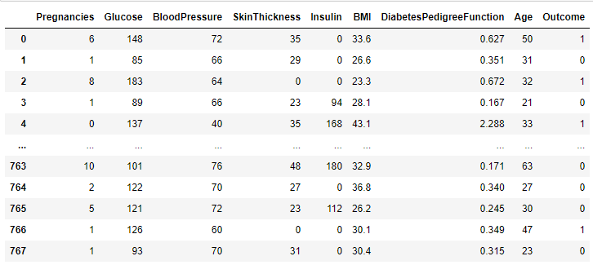
Data Description

Slide 4
DATA DESCRIPTION
The following features provided help us predict whether a person is diabetic or not
Pregnancies : Number of times pregnant
Glucose: Plasma glucose concentration over 2 hours in an oral glucose tolerance test
BloodPressure: Diastolic blood pressure (mm Hg)
SkinThickness: Triceps skin fold thickness (mm)
Insulin: 2-Hour serum insulin (mu U/ml)
BMI: Body mass index (weight in kg/(height in m)2)
DiabetesPedigreeFunction: Diabetes pedigree function (a function which scores likelihood of diabetes based on family history)
Age: Age (years)
Outcome: Class variable (0 if non-diabetic, 1 if diabetic)

Slide 5
Approach
My Approach for prediction of diabetes is
Analysing the data given
Visualising the data by using matplotlib and seaborn python packages
Preprocessing the given data by using standard scaler from sklearn package
Prediction using Support Vector Machine Model

Slide 6
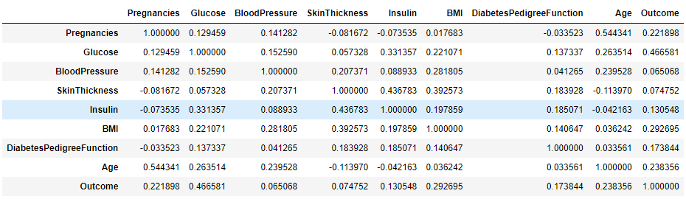
Data Visualization
Finding correlation of every pair of features (and the outcome variable) and visualize the correlations using a heatmap.

Slide 7
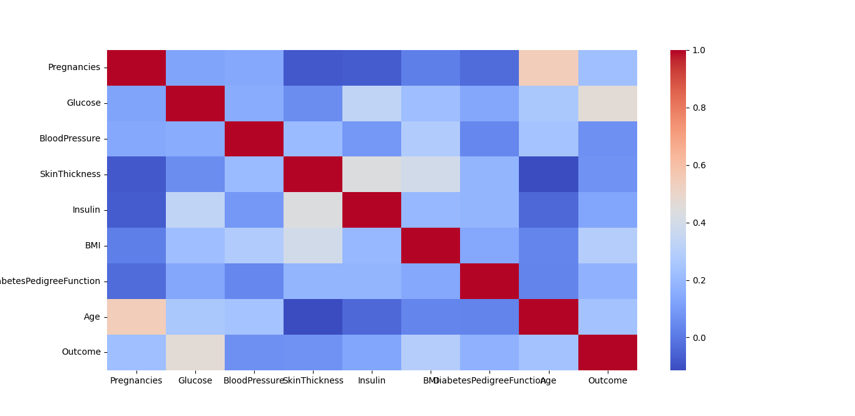
Data Visualization

Slide 8
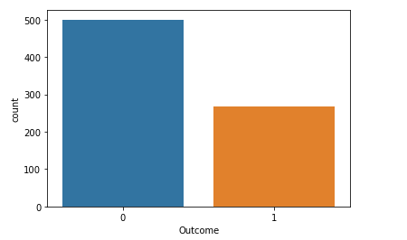
Data Visualization
Bar plot represents number of people in the dataset are diabetic and how many are not

Slide 9
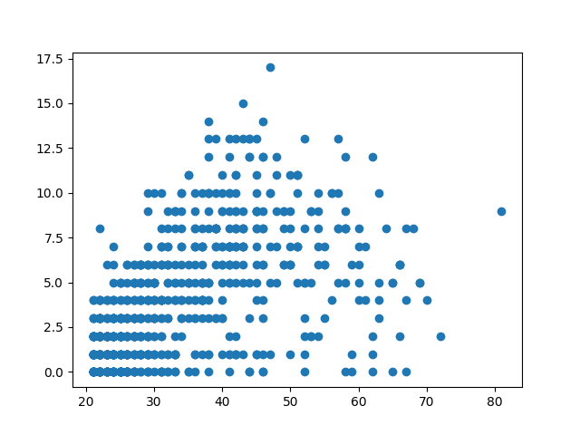
Data Visualization
Scatter plot between Age and Pregnancies

Slide 10
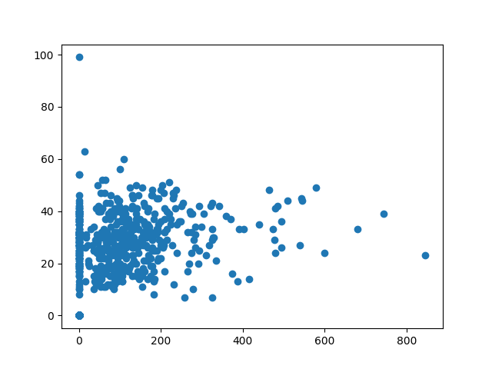
Data Visualization
Scatter plot between Age and Pregnancies

Slide 11
Algorithms / Machine Learning Model
I Have used Support Vector Machine Model for prediction. Since prediction is a classification problem , Support vector machines (SVMs) are particular linear classifiers which are based on the margin maximization principle. They perform structural risk minimization, which improves the complexity of the classifier with the aim of achieving excellent generalization performance. The SVM accomplishes the classification task by constructing, in a higher dimensional space, the hyperplane that optimally separates the data into two categories.
Therefore helps us to disguish between diabetic and non diabetic patient.

Slide 12
Model Evaluation
Training Model
Accuracy of the Training Model is 78.665%
Testing Model
Accuracy of the Testing Model is 77.27%

Slide 13
Conclusion
Support Vector Machine Model gives a optimum accuracy
in the prediction of diabetes enhanced by the usage of Standard Scaler Preprocessing
References
https://towardsdatascience.com/end-to-end-data-science-example-predicting-diabetes-with-logistic- regression-db9bc88b4d16#:~:text=DiabetesPedigreeFunction%3A%20Diabetes%20pedigree%20function%20(a,%2Ddiabetic%2C%201%20if%20diabetic)

Slide 14
Bussiness Recommendation
Support Vector Machine Model gives a optimum accuracy
in the prediction of diabetes enhanced by the usage of Standard Scaler Preprocessing
Hospital can benefit by using this model as it provides a good accuracy and it can reduce the cost of unwanted treating of non diabetes patients and can help in the cure of diabetes patient

Slide 15
Thanks For Viewing
T. Sharon Vijay

